Slide 1
Renovate or Rebuild?: Exploring the architecture of VET
VET Teaching Realising Potential
Dr Lisa Maurice-Takerei
Dr Helen Anderson

Slide 2
Unleashing the Potential. Transforming Tertiary Education, UNESCO, 2015
Benefits of TVET - Economic, social equity, sustainability
TVET is seen by a large number of countries as a key part of the solution to a myriad of challenges including sluggish growth, poverty, inequalities, employability and unemployment (p.25)
An important ingredient in the effort to reduce inequities and promote sustainability
Teachers and trainers have a central role in strengthening TVET systems
The role of TVET teachers and trainers in TVET reform and their developing professionalism are issues that require more research and more careful policy attention. This applies to both initial TVET teacher and trainer education, and continuing training and capacity-building, all of which are needed to support and implement successful TVET reforms (p.115)

Slide 3
A NZ tertiary context
A diverse sector and a diverse workforce - Universities, Polytechnics (ITPs), Private Training Establishments (PTEs), Wananga. Different values placed on qualifications and training around teacher education.
In 2009 there were around 100 publicly listed qualifications offered by NZ providers for tertiary teachers ranging from level 4 to post-graduate (pre TRoQ/MRoQ)
Large differences in support provided by different parts of the sector for in-service qualifications or professional development.

Slide 4
The tertiary teaching workforce
Approx. 27,000 (2012) estimate of those working in Tertiary Education (NZ pop. 4,700,000)
Part of sector | No. of FTEs
Universities | 7,060
ITPs | 4,440
Wānanga | 751
PTEs | 3,370
Total | 15,570
Does not include those working in informal adult education, adult and community education, and Industry and workplace training
Large proportion of tertiary teaching workforce are part time
Aging workforce (older than the NZ workforce as a whole)
Younger staff finding it hard to secure tenured roles
High proportion on temporary or casual contracts
Increasing workloads
Turnover – anecdotally related to restructure, Gender/Ethnicity

Slide 5
Tertiary teaching qualifications and support
ITPs traditionally place high value on teaching quals for full time staff (often inhouse). Provide a requirement to achieve within 2 years of appointment
Universities have generally not had this requirement – they offer staff who are interested qualifications at level 7 and above
PTEs vary but about 40% regard it as an important pre requisite for employment
ITOs require completion of a unit standard in assessment – full qualifications no full picture

Slide 6
Qualifications picture
National qualifications include Certificate and Diploma level
Unsustainable number of graduates
Highly variable - Graduate profiles disparate
Certs Level largest proportion
Diploma smaller proportion (less than half the number over the same period) Expected outcomes from quals vary – a clear need for rationalization
Policy settings require increased accountability for teaching quality
Professionalisation of tertiary teachers is an argument in parallel

Slide 7
Tertiary teaching qualifications reform
A strong sense in the sector that tertiary teachers should be fully equipped to address :
Achieving parity of success for Māori and Pacific learners
Engaging younger learners
Addressing literacy and numeracy needs for tertiary learners
Ensuring all learners have the appropriate digital literacies to support successful study
Providing quality international education both within New Zealand and overseas.
(Ako Aotearoa, 2012. Needs Analysis)

Slide 8
Mandatary review - opportunities
The 2009 targeted review of non-university tertiary certificate and degree qualifications aimed to ensure that qualifications are relevant to the needs of learners, employers and other stakeholders.
One of the key recommendations was that qualification outcome statements be strengthened and standardised. “Graduate profiles are at the heart of the qualifications reforms …” (on the New Zealand Qualifications Framework NZQF).
“To a large extent, graduate profiles [are] the primary measure of the effectiveness of qualifications. It is important to take the time to get them right”
http://www.nzqa.govt.nz/studying-in-new-zealand/understand-nz-quals/reviews-of-qualifications/guidelines-for-reviews-of-qualifications/practice-note-3/

Slide 9
Developing a graduate
The graduate profile focuses on a graduate’s skills (the minimum level of what they can do), knowledge (what they must know) and attributes (what they are capable of being
It is high level and flexible to accommodate changing needs or technologies.
It is written in plain English.
The graduate profile provides the foundations for the development of the qualification specification and the conditions relating to specific outcomes.
Questionable as to whether the pragmatic approach to Graduate Outcomes is adequate (see Barrie, 2004)

Slide 10
Skills, knowledge and attributes
Strategic Purpose Statement
This qualification is for individuals aspiring to or in a career in adult and tertiary teaching or training, including vocational education and training. It is intended for those who already have a qualification or equivalent experience in their primary discipline e.g. a trade. It represents the base level qualification for a professional adult and tertiary teaching practitioner.
http://www.nzqa.govt.nz/nzqf/search/viewQualification.do?selectedItemKey=2993

Slide 11
Skills, knowledge, attributes

Slide 12
Skills, knowledge, attributes
Level 5 – 60 credit
Design for learning to meet specified learning outcomes in a variety of contexts
Create and sustain a learner-centred teaching environment that respects learners’ mana and diverse backgrounds, and the wider educational and societal context, in order to facilitate quality learning
Select and apply facilitation and teaching strategies appropriate to diverse learners
Enhance learning through the application of assessment and moderation practices
Critically evaluate and reflect on own professional practice and explore options to improve it. http://www.nzqa.govt.nz/nqfdocs/quals/pdf/2993.pdf

Slide 13
Level 6 – 120 credits
Design for learning to meet specified learning outcomes in dynamic contexts
Promote teaching environments that give primacy to learners
Explore and implement facilitation and teaching strategies to meet the needs of diverse learners and contexts
Select and implement assessment and consistency management and processes
Undertake kaitiakitanga in an adult and tertiary teaching environment
Provide leadership and professional support to other practitioners working both within and across programmes
Analyse the educational environment and apply knowledge as a basis for influencing own and others’ decision-making, innovation and change.

Slide 14
Conditions
Outcomes should be integrated across programme design in a way that makes it clear outcomes are mutually supportive and not entirely discrete.
In a programme, assessment of all outcomes should be integrated so each assessment task provides evidence of at least two outcomes in ways that demonstrate their interdependence.

Slide 15
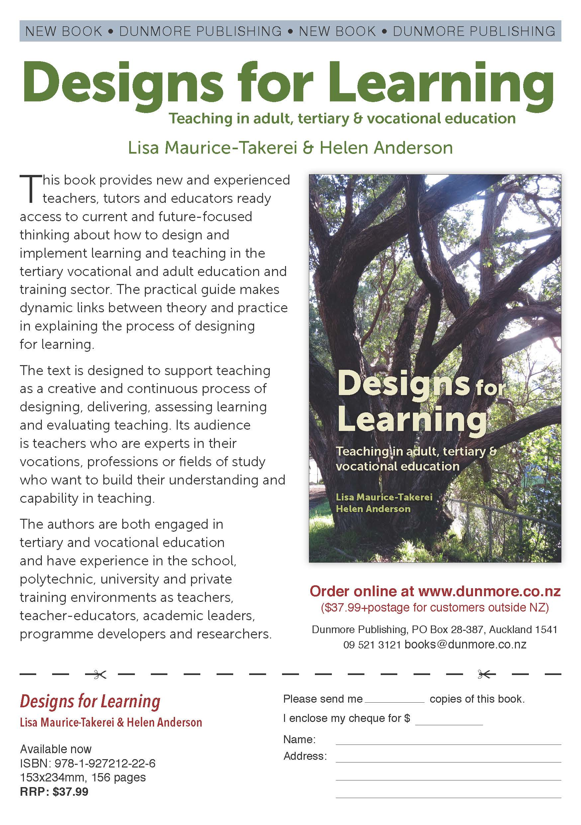
This book represents the collective experience of its authors and the many experts, exemplars and stunningly creative teachers, researchers and writers we have come across in our lives in education.
The book provides new and experienced teachers, tutors and educators ready access to current and future focussed thinking about how to design and implement learning and teaching in the tertiary vocational and adult education and training sector. The practical guide makes links between theory and practice in explaining the process of designing for learning.
The audience for the text is educators who are experts in their fields and who want to build their understanding and capability in teaching that expertise to others.

Slide 16
References
Ako Aotearoa. (2010). Taking Stock. Tertiary Practitioner Education Training and Support https://akoaotearoa.ac.nz/qualificationsstocktake
Ako Aotearoa (2014) ‘Qualifications for Adult and Tertiary Teachers/Educators: Needs Analysis’, in Teacher Education Review Governance Group, Mandatory Review of Teacher Education Qualifications: https://akoaotearoa.ac.nz/ako-aotearoa/ako-aotearoa/resources/pages/stock-take-qualifications-and-support-new-tertiary-teacher
Marope, P., Chakroun, B. and Holmes, K. (2015). Unleashing the Potential. Transforming Technical and Vocational Education and Training. UNESCO, France. http://unesdoc.unesco.org/images/0023/002330/233030e.pdf
Maurice-Takerei and Anderson (2016). Designs for Learning. Teaching in Adult, Tertiary and Vocational Education. Dunmore Press, Auckland.

