Slide 1
Communication Streams on the Blended Learning Journey:
Developing Educator Capability for Blended Delivery
Li Na; Craig Poole
:

Slide 2
Flexibility
Productivity
Engagement
Risk Reduction
Minimal Administration
Cost Reduction
TAFE Queensland
Flexibility
Productivity
Engagement
Improving academic performance
Improving instructor success
Cost Reduction
Blended Learning

Slide 3
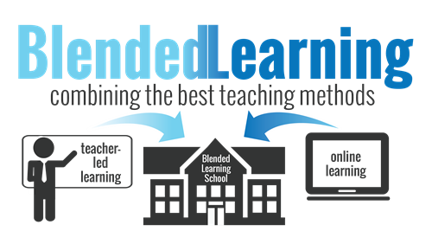
TAFE Queensland
“should be viewed as a pedagogical approach that combines the effectiveness and socialization opportunities of the classroom with the technological enhanced active learning possibilities of the online environment”.
-Dziuban, Hartman, and Moskal (2004)
http://www.greeleyschools.org/Page/13456

Slide 4
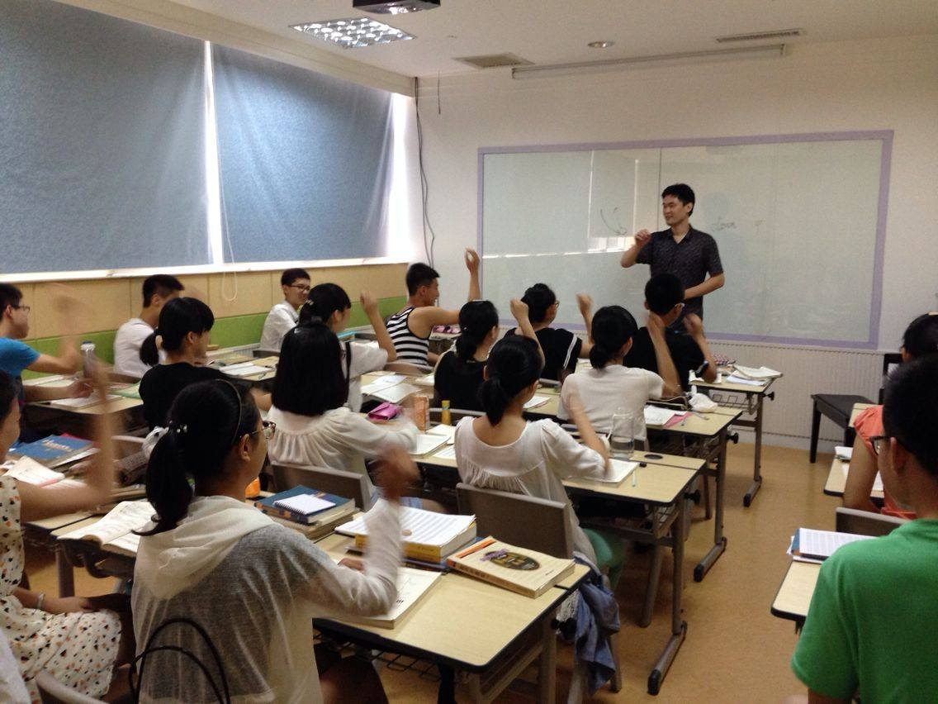
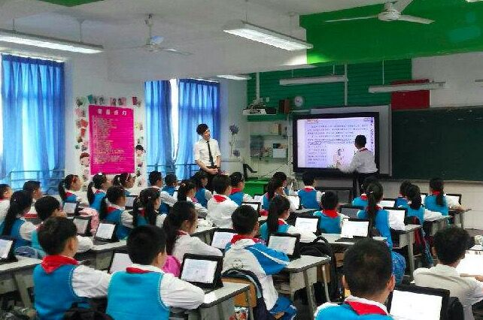
TAFE Queensland
Face-to-face classroom
web-enhanced classroom
http://www.xyyxpx.com/content/?1831.html#p=1

Slide 5
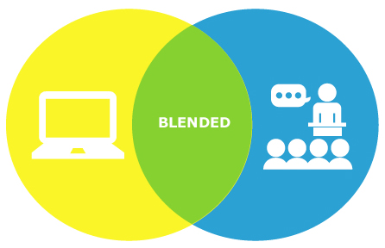
TAFE Queensland
Blended delivery
https://eazysafe.com/blended-learning/

Slide 6
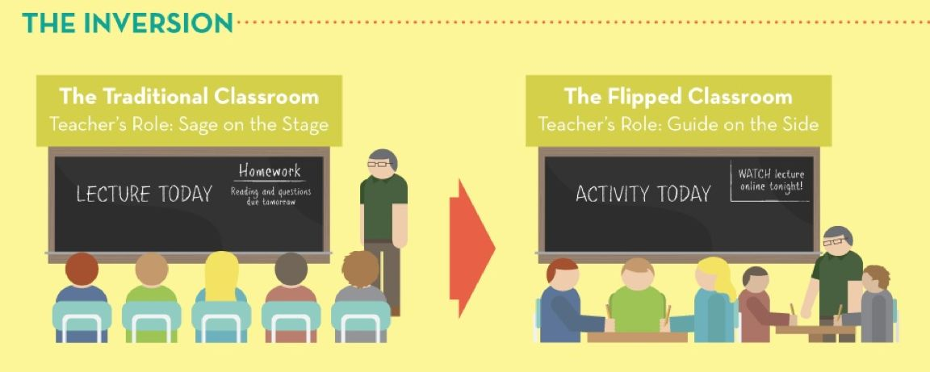
TAFE Queensland
Flipped delivery
http://garydavidstratton.com/2012/03/09/flipped-theology-how-flipping-your-classroom-increases-learning/

Slide 7
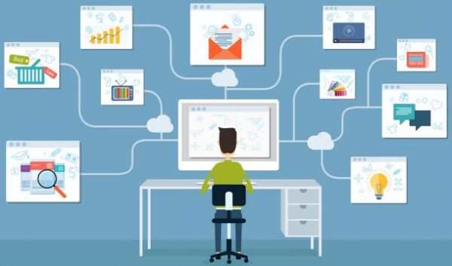
TAFE Queensland
Online delivery
http://www.icrosschina.com/insideout/2016/0330/24971.shtml

Slide 8
TAFE Queensland
Continuum
Blended Course
Classroom Course
Web-enhanced Course
Online Course
Flipped
online course activity + in-person classroom activity
reduced seat time
In-person classroom
face-to-face meetings
not reduce
seat time
All course activity is done online

Slide 9
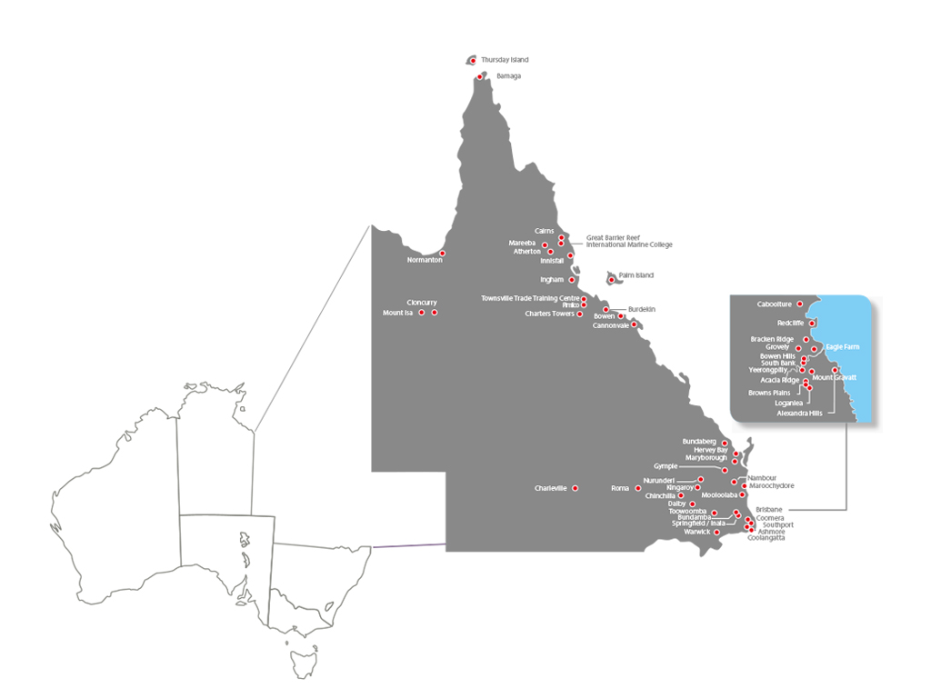
TAFE Queensland
Research method
Stronger Employers

Slide 10
TAFE Queensland
Stronger Employers

Slide 11
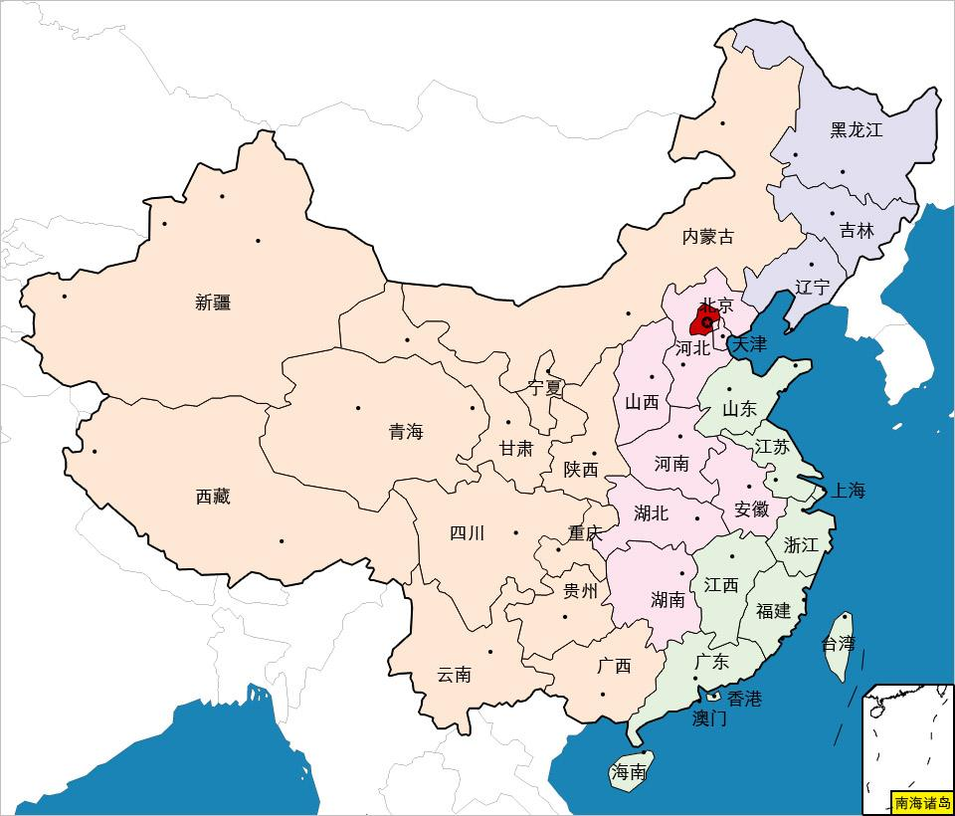
TAFE Queensland

Slide 12
TAFE Queensland
Interview Questions
How do you believe learners might benefit from blended delivery?
Do you think there are benefits to blended delivery as a learning and teaching approach from educators’ perspective? If yes, what are some of the main benefits?
Do you think certain programs or units are better suited to blended delivery? If yes, what factors should be considered?
If you think there are challenges with blended delivery, what are they?
Do you think your educators are willing to build their capability around blended delivery?
In your opinion, to what extent is blended delivery currently used within your faculty or region?
Can you give an example of blended delivery within your faculty or region?
What impact do you think the current practice of blended delivery is having on learning and teaching?
Do you think more support from TAFE Queensland would be worthwhile? If yes, what form/s of support would you recommend?
Do you believe the structure of educator training programs will be important to the uptake and impact of blended delivery? If yes, can you suggest how the training should be designed and implemented?
Interview
Your perspective on blended delivery as a delivery approach to deliver training using blended learning;
Your opinion about the current capability of your educators;
Current support to implement blended learning.

Slide 13
TAFE Queensland
capability
support
Benefit
innovation
Challenges
Findings

Slide 14
TAFE Queensland
Benefit learners: more opportunities;
flexibility of study;
suits different learning styles;
offers more control;
learn at their own pace and schedule
Benefit
Benefit educators: extend geographic reach;
flexibility;
teaching approach shifting;
Course design debate: Theoretical subject may suit more?
Can highly practical programs fit?
Can high risk training fit?

Slide 15
TAFE Queensland
Technological infrastructure
Misconceptions
Attitudinal barriers
Lack of ‘Employer’ buy-in
Inadequate time
Support and training
Challenges

Slide 16
TAFE Queensland
Technological infrastructure
“region differences”
“internet bandwidth”
“hardware, download capacity”
“If infrastructure isn’t working it will lead to student frustration.”
Challenges

Slide 17
TAFE Queensland
Misconceptions
“taking what happens in the classroom and resources and placing them online.”
“bring learners to classroom and sit in front of computers”
“loss of face”
“If one thing goes wrong, they think everything goes wrong.”
Challenges

Slide 18
TAFE Queensland
Attitudinal barriers
“Experienced teachers may be used to traditional face to face delivery. Newer teachers are more tech savvy.”
“going blended = staff cut”
“You must…; You have to…; go blended before…date”
“school leavers and younger students are more comfortable with digital tools”
“older learner cohorts more self-motivation
and higher self-directed”
Challenges

Slide 19
TAFE Queensland
Lack of ‘Employer’ buy-in
“Employers send apprentices to college to learn when they have spare time, but it doesn’t marry well with blended delivery. ” - example in trades
Challenges

Slide 20
TAFE Queensland
Inadequate time
“puts more pressure on learners to manage their own time… educators need better upfront preparation to deliver. ”
“Time is needed to collect resources, review and filter them and get the technical work done ”
current usage of blended delivery across the state is not high
Challenges

Slide 21
TAFE Queensland
Support and Training
“Blended delivery can never be a ‘one size fits all, watch this’ type of training. ”
“It must be nuanced to regions!”
“…educators need 1 – 2 weeks ‘offline’ to prepare for blended delivery ”
“No. 1 focus is on pedagogy … the technology (LMS, iPads, mobile devices) is secondary to pedagogical strategies”
Challenges

Slide 22
TAFE Queensland
China Comparison
Uniform Student Cohort
unpublished data from WTP-Wuhan Polytechnic 2016
Notes:
What if they included TAFE in their measurement?

Slide 23
TAFE Queensland
China and Australia Comparison
Blended learning benefits
Pedagogy focus
Suitable programs?

Slide 24
TAFE Queensland
Conclusion
Challenges
Communication

Slide 25
TAFE Queensland
Communication Between
Technological infrastructure
Misconceptions
Attitudinal barriers
Inadequate time
Support and training
Administration and educators

Slide 26
TAFE Queensland
Communication Between
Misconceptions
Attitudinal barriers
Inadequate time
Educators and educators

Slide 27
TAFE Queensland
Communication Between
Misconceptions
Attitudinal barriers
Inadequate time
Support and training
Educators and learners

Slide 28
Training programs allow educators sufficient time to:
TAFE Queensland
Recommended Training
fully understand the concept of blended learning;
develop digital literacy skills;
identify courses which suit a blended approach and redesign their learning and teaching strategies accordingly; and
develop the confidence to implement blended delivery within their specific context (and within any identified technology constraints).

Slide 29
Thank You!

