Slide 1
LEARNER PATHWAYS: MEETING THE HIGHER SKILLS AND QUALIFICATIONS AGENDA
Allison Miller
Higher Qualification Pathways Business Manager
Thursday 12 April 2012

Slide 2
What is a learner pathway?

Slide 3
Main pathways taken by Australian students between these sectors
Source: Australian National Report on the Development and State of the Art of Adult Learning and Education (DEEWR)
http://www.unesco.org/fileadmin/MULTIMEDIA/INSTITUTES/UIL/confintea/pdf/National_Reports/Asia%20-%20Pacific/Australia.pdf

Slide 4
Source: Australian National Report on the Development and State of the Art of Adult Learning and Education (DEEWR)
http://www.unesco.org/fileadmin/MULTIMEDIA/INSTITUTES/UIL/confintea/pdf/National_Reports/Asia%20-%20Pacific/Australia.pdf

Slide 5
Vocational education & training (VET) targets:
By 2020:
Halve the proportion of Australians ages 20-64 without qualifications at Certificate III and above
Double the number of higher qualification completions (diploma and advanced diploma)
Council of Australian Governments (COAG)
National agreement for skills and workforce development
2009

Slide 6
Higher Education (HE) targets:
By 2020:
40 per cent of 25- to 34-year-olds will have attained at least a bachelor-level qualification
(2009 attainment was 29 per cent)
Commonwealth of Australian
National agreement for skills and workforce development
2009

Slide 7
Image Source:
http://www.mountbatten.org/mipweb.nsf/pages/ld_mba_qualification
We need people to have more than one qualification (Jones, 2010):
there’s not enough Australians to achieve these targets otherwise

Slide 8
What is the ‘new’ Australian tertiary sector?
Notes:
8

Slide 9
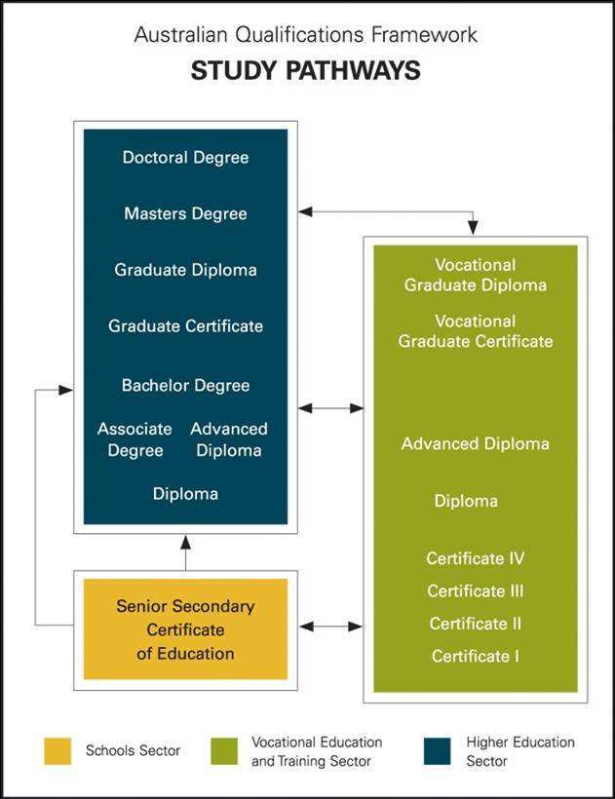
New Tertiary Sector
Image from: http://www.beegazine.com/web/index.php?option=com_content&view=article&catid=36%3Aoversea-story&id=46%3Astart-point&Itemid=75

Slide 10
Ass Prof Leesa Wheelahan (2010, 2011):
diplomas are the “main transition qualification” from VET to higher education
getting students into diplomas in the first place is as important as encouraging them to articulate to degrees
better partnerships between VET & HE Providers to deliver associate degrees which articulate to HE quals
Image Source:
http://www.lhmartininstitute.edu.au/insights-blog/2011/02

Slide 11
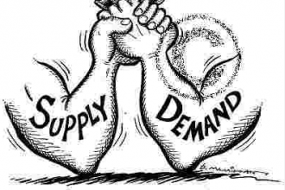
Demand drive competitive markets:
VET Sector Reforms – uncapping training places & VET FEE HELP (SA Govt, 2011, Victorian Govt, 2008)
No longer specifying no of undergraduate places (DEEWR, ND)
Stealing from each other’s client base:
Degrees at TAFE (TAFE NSW Higher Education, ND)
University “Colleges” (UniSA, 2010)
Image Source:
http://ecompunk.com/2011/04/18/moving-from-supply-driven-to-demand-driven-commerce/

Slide 12
Are learner pathways linear in nature?
Notes:
12

Slide 13
Pathways within and between adult education
Crazy paving or stepping stones?
Harris et al, 2006
Image by Chris Downer– Bournemouth: artful paving in The Square: - http://www.geograph.org.uk/photo/1658790
Notes:
13
13
Group Brainstorm and discussion

Slide 14
Articulation Pathways
11% of VET students who obtain a VET qualification obtain a degree
14% of students with a Bachelor degree obtain a VET qualification
4.3% of students with a VET qualification gain credit
This is despite 25 years of articulation arrangements and dual sector universities
ABS (2011) Perspectives on Education and Training: Pathways in VET
Slide from: Diane Paez’s 2012 Higher Qualification Pathways Project Presentation
14

Slide 15
Effective learner pathways require:
Streamlined pathways
Improved learner support systems
Better ways of helping learners gain credit and recognition of prior learning
Developing a culture of ongoing development
Miller, 2010/2012

Slide 16
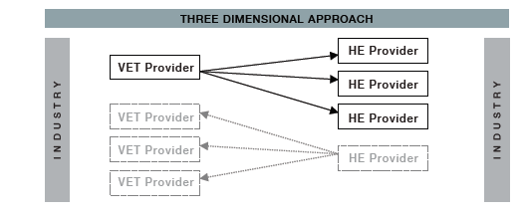
3D Focus on Articulation Pathways
The Corporate Strategy Approach to Articulation and Credit Transfer
Paez D, Byrnes J, Blacker J, Jackson A, Dwyer C
http://3darticulation.com.au/

Slide 17
3D Focus on Articulation Pathways
Articulation Pathway Models – A visual guide to pathways between VET and HE
Paez D, Byrnes J, Blacker J, Jackson A, Dwyer C
http://3darticulation.com.au/

Slide 18
3D Focus on Articulation Pathways
Articulation Pathway Models – A visual guide to pathways between VET and HE
Paez D, Byrnes J, Blacker J, Jackson A, Dwyer C
http://3darticulation.com.au/

Slide 19
How can we support learner pathways?
Notes:
19

Slide 20
2012-2015 NATIONAL VET E-LEARNING STRATEGY
GOAL 1: NBN
GOAL 3: ACCESS AND PARTICIPATION
GOAL 2: WORKFORCE DEVELOPMENT
Develop and utilise e-learning strategies to maximise the benefits of the national investment in broadband
1.1 NBN E-learning Programs
1.2 New Generation Technologies for Learning
1.3 Broadband Content Services
Support workforce development in industry through innovative training solutions
2.1 Industry System Change
Expand participation and access for individuals through targeted e-learning approaches
3.1 Partnerships for Participation
3.2 Access to Skills
3.3 Learner Pathways

Slide 21
Approach:
3.3.3 Support learner pathways to higher skill levels by co-investing with RTOs, industry and community organisations to develop innovative technology-based programs to allow employees and other individuals to gain higher VET qualifications, skills sets and/or entry into higher education

Slide 22
Higher Qualification Pathways Projects:
Notes:
Reminder of the 8 projects who have been funded for the January-June 2012 Higher Qualification Pathways project

Slide 23
Conclusions (to date):
Encouraging Australians to gain more than one qualification
Funding models which encourages
collaborative partnerships between VET/HE provider (3D Focus on Articulation Pathways)
Developing a culture of ongoing development (through innovative technology-based approaches and improved digital literacy)

Slide 24
Contact me
Allison Miller
Higher Qualification Pathways Business Manager
Allison.Miller@flexiblelearning.net.au
0400 732 270

